Slide 1


Daria Solodey
Methodist, course creator, English teacher

Slide 2
🔥
Our goal
Pass a job interview
Our rules:
Turn on your camera
Set up your microphone
Be active
Notes:
Если вам не хватило места, вы можете здесь написать развернутый комментарий.

Slide 3

Lesson Plan
- present the project
- discuss what question to ask at the job interview
Notes:
Развернутый комментарий.

Slide 4
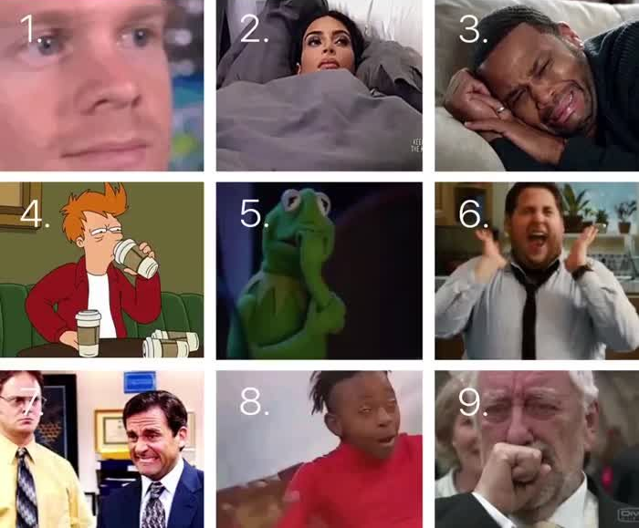
Which meme are you today?
Do you remember what we are doing this class?

Slide 5

Are you ready to present your project?

Slide 6
Present your project
S T A R
Situation
Task
Action
Result
The purpose of my talk is…
Our main task was to…
Throughout the project, we faced the problem of…
The project solves the problem of…
Thanks to the… , you will…
The benefit of this project is that…
I’d like to present you my team. It consists of … developers.
Finally, I’d like to thank my talented team for…
I was in charge of…
My tasks were to…
Notes:
Optional slide, if students need help

Slide 7

You rock!

Slide 8
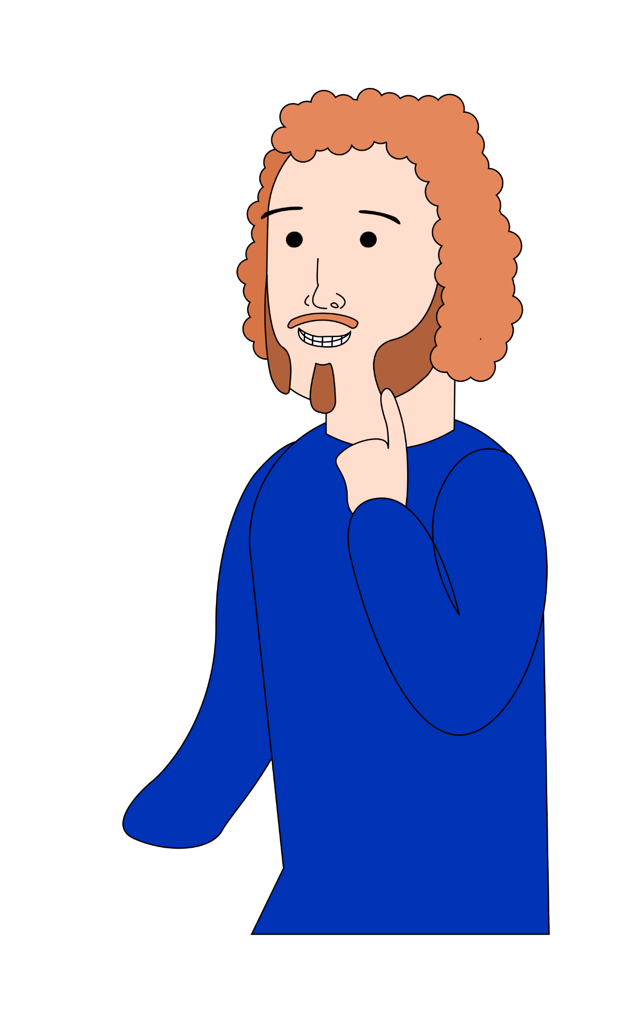
Do you prefer asking or answering questions? Why?
What professionals are good at asking questions?
What kind of people should be good at answering
questions?
In what situations do we ask questions?

Slide 9

Why is it essential to prepare a speech for your presentation in advance?
What else should you prepare before the interview?

Slide 10
Why is it essential to prepare a speech for your presentation in advance?
What else should you prepare before the interview?
Why is it important for candidates to ask questions after the interview?

Slide 11
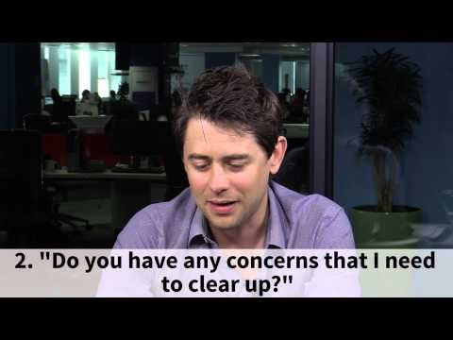
Watch the video and answer the questions
Why is it important for candidates to ask questions after the interview?

Slide 12
Why is it important for candidates to ask questions after the interview?
Let’s check the answers!

Slide 13
Why is it important for candidates to ask questions after the interview?
It is important for you as a candidate to make sure that you have all the information you need to make a properly informed decision.

Slide 14
Why is it important for candidates to ask questions after the interview?
It is important for you as a candidate to make sure that you have all the information you need to make a properly informed decision.
It’s not just about whether you are good enough for the job, but if the job is good enough for you.

Slide 15
Why is it important for candidates to ask questions after the interview?
It is important for you as a candidate to make sure that you have all the information you need to make a properly informed decision.
It’s not just about whether you are good enough for the job, but if the job is good enough for you.
By asking questions you can help demonstrate that you are truly an awesome candidate for the job.

Slide 16
Why is it important for candidates to ask questions after the interview?
It is important for you as a candidate to make sure that you have all the information you need to make a properly informed decision.
It’s not just about whether you are good enough for the job, but if the job is good enough for you.
By asking questions you can help demonstrate that you are truly an awesome candidate for the job.
When you don’t ask questions, you aren’t really demonstrating that you are interested in the opportunity.

Slide 17

Look at the pictures and try to guess the questions you may ask at the job interview. Discuss your ideas with the teacher.
Then check yourself.

Slide 18
What questions would you ask your employer? Explain your choice.
What opportunities for professional development does your company offer?
What technology stack will I have to work with?
How do you currently support or mentor junior developers?
Do you provide health insurance?
How is teamwork built?
Do you already know which project I will work on?
What expectations should the intern meet in order to successfully move to the position of junior developer in 2 months?
Could you tell me about the compensation that’s being offered for this role?
Tell me a bit more about the hiring process.
Is corporate training provided? If yes, in what format?
Currently, I am still working in the company. In case of the beginning of our cooperation with you, will it not be a problem if I have to work for 14 days at the previous place?
Does your company use SCRUM in the development process, or some other methodology?
Are there any other questions you would like to ask?

Slide 19

What can you do after this lesson?
I learned:
How to answer the questions:
Why did you leave your previous job?
What are you looking for in your next job and employer?
Notes:
Развернутый комментарий

Slide 20
Useful links:
Tasks:
https://wordwall.net/ru/resource/35694362 - jobs
https://wordwall.net/resource/35819887 - vocabulary

Slide 21
Thank you!

